Slide 1
Intro to Infrastructure as Code
Introduction to Chef
RailsConf – April 2015
https://github.com/chef/railsconf2015-chef/

Slide 2

Nell Shamrell
Community Software Engineer at Chef
Works on Supermarket
<3’s Regular Expressions
Naginata Practitioner (naginata.org)
@nellshamrell
nshamrell@chef.io

Slide 3


Nathen Harvey
Community Director at Chef
Co-host of the Food Fight Show
Co-organizer of DevOpsDC meetup
Occasional farmer – http://bit.ly/farmer-nathen
Love Eggs – http://eggs.chef.io
@nathenharvey
nharvey@chef.io

Slide 4
Hello!
System Administrator?

Slide 5
Hello!
System Administrator?
Developer?

Slide 6
Hello!
System Administrator?
Developer?
DevOp?

Slide 7
Hello!
System Administrator?
Developer?
DevOp?
Business Person?

Slide 8
Are you experienced?
Experience with Infrastructure as Code or Configuration Management?

Slide 9
Are you experienced?
Experience with Infrastructure as Code or Configuration Management?
Experience with Chef?

Slide 10
The 80s: The Decade that Made Us
…and will help define “DevOps”

Slide 11

Run DMC
https://www.morrisonhotelgallery.com/photo/default.aspx?photographID=7360

Slide 12
Run DMC
Oh, hell no! This is hillbilly gibberish
https://www.morrisonhotelgallery.com/photo/default.aspx?photographID=7360

Slide 13
Run DMC
Oh, hell no! This is hillbilly gibberish
I don’t understand this code
https://www.morrisonhotelgallery.com/photo/default.aspx?photographID=7360

Slide 14

Aerosmith
Oh, hell no! This is hillbilly gibberish
I don’t understand this code
http://www.mikethefanboy.com/wp/wp-content/uploads/2012/04/Aerosmith-005.jpg
https://www.morrisonhotelgallery.com/photo/default.aspx?photographID=7360

Slide 15
Aerosmith
What the hell are they doing to our song?
Oh, hell no! This is hillbilly gibberish
I don’t understand this code
http://www.mikethefanboy.com/wp/wp-content/uploads/2012/04/Aerosmith-005.jpg
https://www.morrisonhotelgallery.com/photo/default.aspx?photographID=7360

Slide 16
Aerosmith
What the hell are they doing to our song?
Oh, hell no! This is hillbilly gibberish
It works fine on my machine
I don’t understand this code
http://www.mikethefanboy.com/wp/wp-content/uploads/2012/04/Aerosmith-005.jpg
https://www.morrisonhotelgallery.com/photo/default.aspx?photographID=7360

Slide 17
What happened?
Producer Rick Rubin put Run DMC & Aerosmith in the studio together
“It was crazy good, man”

Slide 18
DevOps
A cultural and professional movement, focused on how we build and operate high velocity organizations, born from the experiences of its practitioners.
https://github.com/chef/devops-kungfu
Notes:
This is the definition of DevOps that comes from Chef Style DevOps Kung fu. You can:
Watch the video from ChefConf
Read the document on GitHub
Join the school

Slide 19
Which version control system do your use?

Slide 20
Which version control system do your use?
cp foo foo.bak

Slide 21
Which version control system do your use?
cp foo foo.bak
cp foo{,.`date +%Y%m%d%H%M`}

Slide 22
Which version control system do your use?
cp foo foo.bak
cp foo{,.`date +%Y%m%d%H%M`}
cp foo{,.`date +%Y%m%d%H%M`-`$USER`}

Slide 23
Infrastructure as Code

Slide 24
The Rails Admin’s Journey
git push heroku

Slide 25
The Rails Admin’s Journey
git push heroku
ssh

Slide 26
The Rails Admin’s Journey
git push heroku
ssh
Store notes in ~/server.txt

Slide 27
The Rails Admin’s Journey
git push heroku
ssh
Store notes in ~/server.txt
Move notes to the wiki

Slide 28
The Rails Admin’s Journey
git push heroku
ssh
Store notes in ~/server.txt
Move notes to the wiki
Write some scripts (setup.sh, fixit.sh, etc.)

Slide 29
The Rails Admin’s Journey
git push heroku
ssh
Store notes in ~/server.txt
Move notes to the wiki
Write some scripts (setup.sh, fixit.sh, etc.)
Golden images and snapshots

Slide 30
The Rails Admin’s Journey
git push heroku
ssh
Store notes in ~/server.txt
Move notes to the wiki
Write some scripts (setup.sh, fixit.sh, etc.)
Golden images and snapshots
Remote execution via ssh

Slide 31
The Rails Admin’s Journey
git push heroku
ssh
Store notes in ~/server.txt
Move notes to the wiki
Write some scripts (setup.sh, fixit.sh, etc.)
Golden images and snapshots
Remote execution via ssh
Policy-driven configuration management

Slide 32

Benefits of Automation

Slide 33
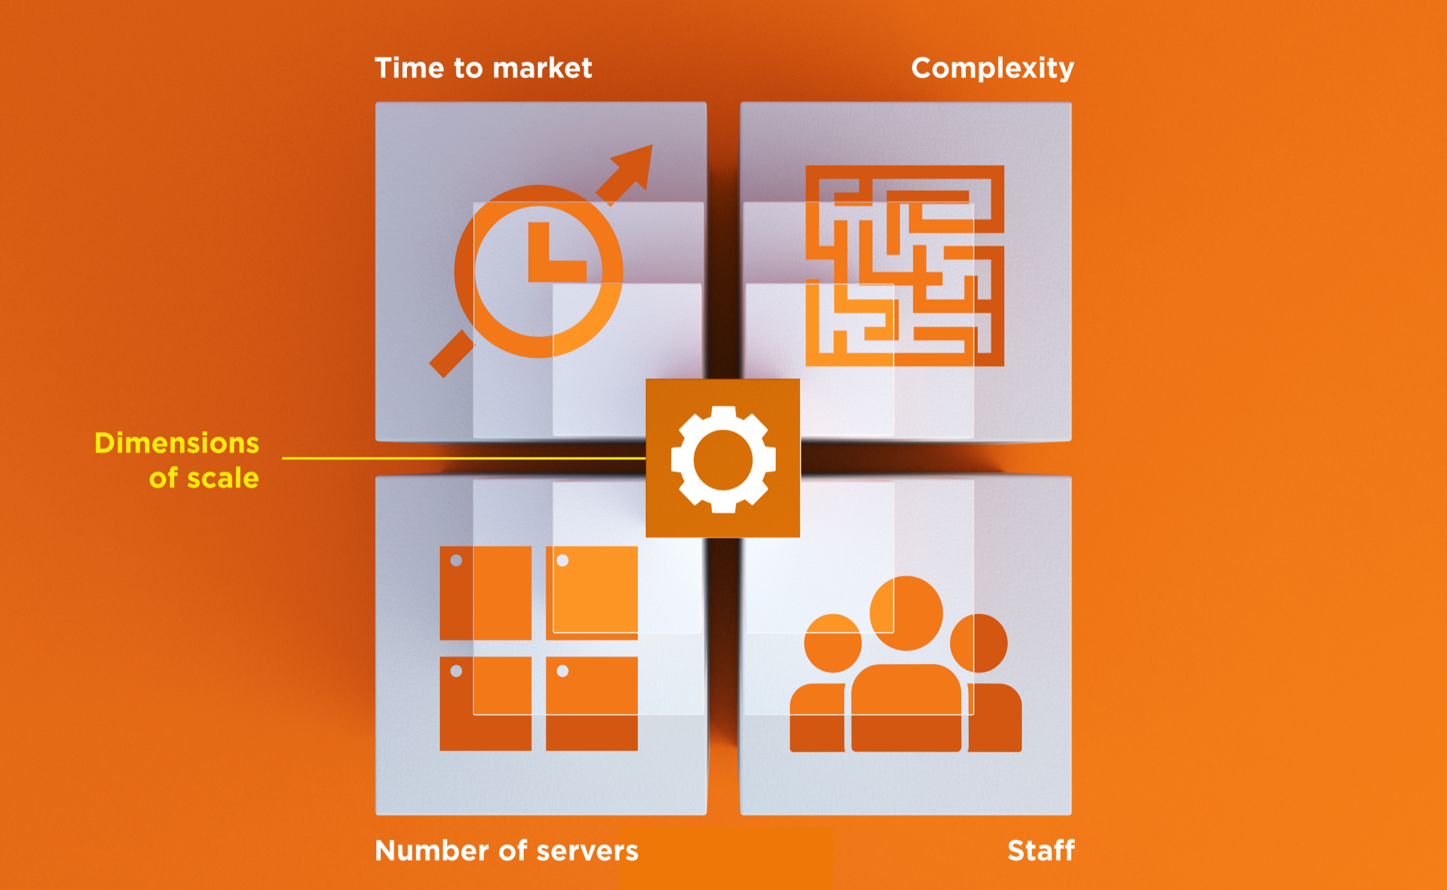
Dimensions of Scale

Slide 34
Automation Platform
Creates a dependable view of your entire network’s state.
Can handle complex dependencies among the nodes of your network.
Is fault tolerant.
Is secure.
Can handle multiple platforms
Can manage cloud resources
Provides a foundation for innovation

Slide 35
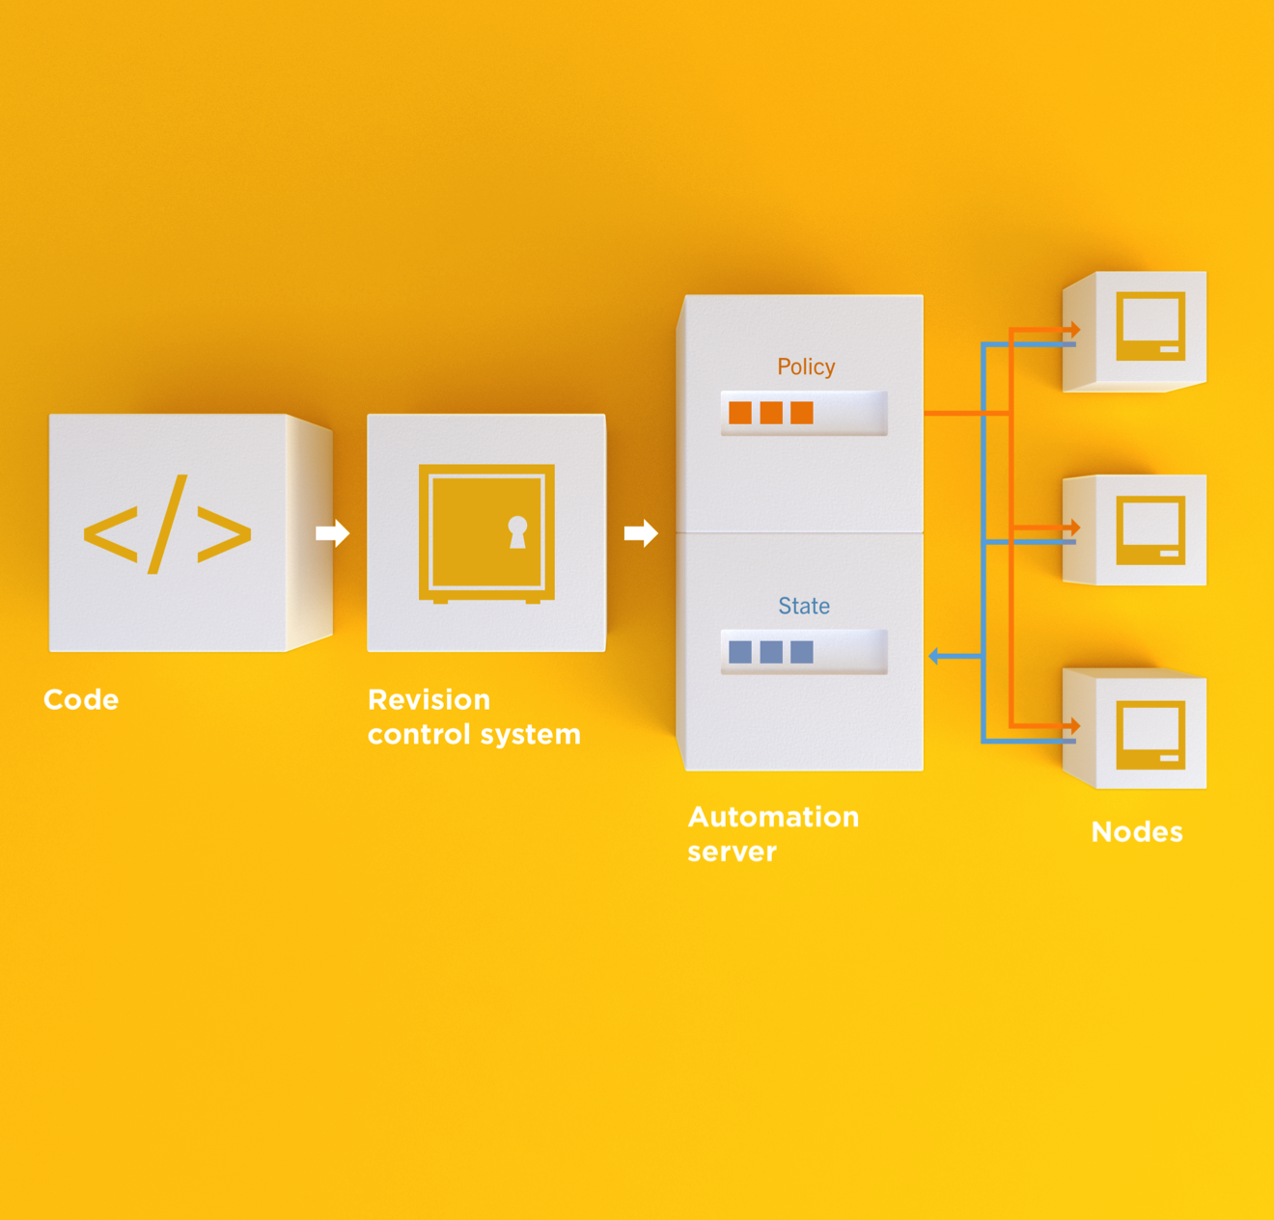
Infrastructure as Code
Programmatically provision and configure components
Notes:
Use the Chef framework and Chef programming language to define the components of your infrastructure. This allows you to capture and document the shape of your infrastructure in a consistent way.

Slide 36
Infrastructure as Code
Treat like any other code base
Notes:
Treat this like any other code base:
Store the code in a version control system.
Add automated tests to the code.
Refactor the code over time.
Build and version software artifacts (e.g. packages)
The code is executable documentation.
Store the code in a version control system.

Slide 37
Infrastructure as Code
Reconstruct business from code repository, data backup, and compute resources
Notes:
With your infrastructure now fully captured in code, you are now able to rebuild your entire business, well, at least all of your business’s applications, with your code repository, a backup of your data, and compute resources, be they bare metal, virtual machines, or cloud instances.

Slide 38
Infrastructure as Code
Programmatically provision and configure components
Treat like any other code base
Reconstruct business from code repository, data backup, and compute resources
Notes:
Stop for a minute and think about what we're saying here. Think about how freeing this can be. The next configuration change you need to make in production starts with a commit to your version control system. You can re-provision your infrastructure with another service provider; move from the data center to the clould and back again.How will this impact the way you run operations in your organization?What questions do you have?

Slide 39
Policy-based
You capture the policy for your infrastructure in code
A program ensures each node in your infrastructure complies with the policy
A control loop keeps the system stable and allows for change when policy is updated

Slide 40
Sample Infrastructure
Graphite
Nagios
Rails
Memcache
Postgres Slaves
Postgres Master

Slide 41
New Compliance Mandate!
Graphite
Nagios
Rails
Memcache
Postgres Slaves
Postgres Master

Slide 42
New Compliance Mandate!
Graphite
Nagios
Rails
Move SSH off of port 22
Let’s put it on 2022
Memcache
Postgres Slaves
Postgres Master

Slide 43
6 Golden Images to Update
Graphite
1
1
Nagios
1
1
1
1
1
Rails
1
1
Memcache
1
1
Postgres Slaves
1
Postgres Master

Slide 44
6 Golden Images to Update
Graphite
1
2
Nagios
3
Rails
/etc/ssh/sshd_config
--- a/sshd_config
+++ b/sshd_config
-Port 22
+Port 2202
4
Memcache
5
Postgres Slaves
6
Postgres Master

Slide 45
12 Instances to replace
Graphite
1
2
Nagios
3
4
5
6
7
Rails
Launch
Delete
Repeat
Typically manually
8
9
Memcache
10
11
Postgres Slaves
12
Postgres Master

Slide 46
Done in maintenance window
Graphite
1
2
Nagios
3
4
5
6
7
Rails
High stakes
Late hours
Risky change
8
9
Memcache
10
11
Postgres Slaves
12
Postgres Master

Slide 47
New configurations required?
Graphite
Nagios
Rails
Do the new instances have new IP Addresses?
* Not all connections shown
Memcache
Postgres Slaves
Postgres Master

Slide 48
Golden Images vs. Policy-based

Slide 49
Chef
Fast, scalable, flexible IT automation

Slide 50
What is Chef
Open source framework for managing complexity in your infrastructure through policy-driven automation code
A community of professionals
A company
Notes:
~60K professionals

Slide 51
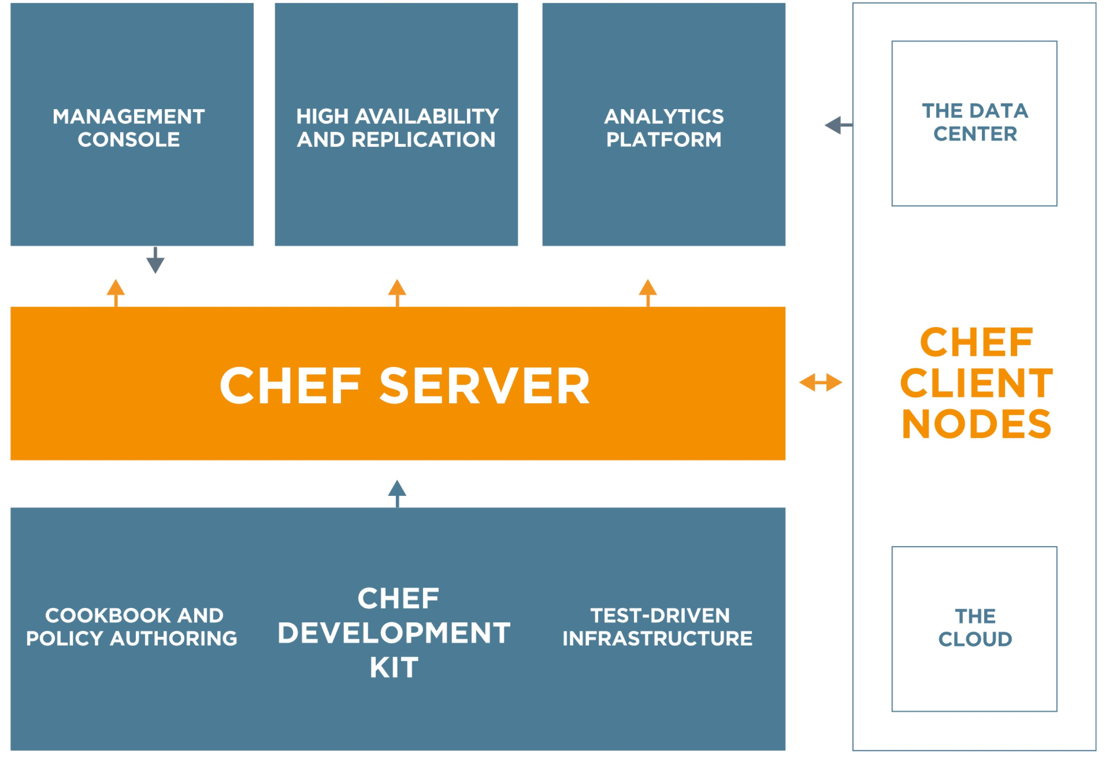
Chef
https://www.chef.io/chef/
Notes:
All Open Source!

Slide 52
Chef Server – Policy & State
Notes:
Policy –

Slide 53
Desired Configuration

Slide 54
Desired Configuration

Slide 55
Desired Configuration

Slide 56
Chef Server – Policy & State
Notes:
Policy –

Slide 57
HA Proxy Configuration

Slide 58
HA Proxy Configuration

Slide 59
HA Proxy Configuration

Slide 60
HA Proxy Configuration

Slide 61
HA Proxy Configuration

Slide 62
HA Proxy Configuration

Slide 63
HA Proxy Configuration

Slide 64
HA Proxy Configuration

Slide 65
Building your policy
Resources and Recipes
Notes:
Policy is defined as a collection of resources in recipes. There are lots of abstractions on top of this but resources are the basic building blocks.

Slide 66
Resources
Piece of the system and its desired state

Slide 67
Resources - Package
Package that should be installed
package "mysql-server" do
action :install
end

Slide 68
Resources - Service
Service that should be running and restarted on reboot
service "iptables" do
action [ :start, :enable ]
end

Slide 69
Resources - Service
File that should be generated
file "/etc/motd" do
content "Property of Chef Software"
end

Slide 70
Resources - Cron
Cron job that should be configured
cron "restart webserver" do
hour '2'
minute '0'
command 'service httpd restart'
end

Slide 71
Resources - User
User that should be managed
user "nginx" do
comment "Nginx user <nginx@example.com>"
uid 500
gid 500
supports :manage_home => true
end

Slide 72
Resources - DSC
DSC resource that should be run
dsc_script 'emacs' do
code <<-EOH
Environment 'texteditor'
{
Name = 'EDITOR'
Value = 'c:\\emacs\\bin\\emacs.exe'
}
EOH
end

Slide 73
Resources – Registry Key
Registry key that should be created
registry_key "HKEY_LOCAL_MACHINE\\SOFTWARE\\Microsoft\\Windows\\CurrentVersion\\Policies\\System" do
values [{
:name => "EnableLUA",
:type => :dword,
:data => 0
}]
action :create
end

Slide 74
Resources
Piece of the system and its desired state
http://docs.chef.io/chef/resources.html

Slide 75
Lab – Install a text editor
Problem: Our workstation does not have $EDITOR installed
Success Criteria: You can edit files with $EDITOR
$EDITOR is your favorite command line text editor: vim, emacs, or nano

Slide 76
What’s up with the card?
http://bit.ly/rails-chef-tdd
Login: chef
Password: [REDACTED]

Slide 77
Login to your lab machine
ssh chef@54.164.75.30
The authenticity of host '54.165.227.226 (54.165.227.226)' can't be established.
RSA key fingerprint is c1:ec:ab:66:fb:22:4a:8f:c2:c5:9b:26:77:f3:dd:b3.
Are you sure you want to continue connecting (yes/no)? yes
Warning: Permanently added '54.165.227.226' (RSA) to the list of known hosts.
chef@54.165.227.226's password:

Slide 78
Welcome to your workstation
ChefDK version 0.4.0 is installed
chef --version
Chef user has passwordless sudo access
sudo cat /etc/shadow

Slide 79
Is $EDITOR installed?
which vim
/usr/bin/which: no vim in (/opt/chefdk/bin:/home/chef/.chefdk/gem/ruby/2.1.0/bin:/opt/chefdk/embedded/bin:/usr/local/bin:/bin:/usr/bin:/usr/local/sbin:/usr/sbin:/sbin:/home/chef/bin)

Slide 80
chef-apply
chef-apply is an executable program that allows you to work with resources
Is included as part of the ChefDK
A great way to explore resources
NOT how you’ll eventually use Chef in production

Slide 81
Install vim
sudo chef-apply -e "package 'vim'"
Recipe: (chef-apply cookbook)::(chef-apply recipe)
* package[vim] action install
- install version 7.2.411-1.8.el6 of package vim-enhanced

Slide 82
Install emacs
sudo chef-apply -e "package 'emacs'"
Recipe: (chef-apply cookbook)::(chef-apply recipe)
* package[emacs] action install
- install version 23.1-25.el6 of package emacs

Slide 83
Install nano
sudo chef-apply -e "package 'nano'"
Recipe: (chef-apply cookbook)::(chef-apply recipe)
* package[nano] action install
- install version 2.0.9-7.el6 of package nano

Slide 84
Resources
Describe the desired state
Do not need to tell Chef how to get there
What happens if you re-run the chef-apply command?

Slide 85
Install $EDITOR again with chef-apply
sudo chef-apply -e "package 'vim'"
Recipe: (chef-apply cookbook)::(chef-apply recipe)
* package[vim] action install (up to date)

Slide 86
Test and Repair
Resources follow a test and repair model
package "vim"

Slide 87
Test and Repair
Resources follow a test and repair model
package "vim"
Is vim installed?
Test

Slide 88
Test and Repair
Resources follow a test and repair model
package "vim"
Is vim installed?
Test
Yes

Slide 89
Test and Repair
Resources follow a test and repair model
package "vim"
Is vim installed?
Test
Yes
Done

Slide 90
Test and Repair
Resources follow a test and repair model
package "vim"
Is vim installed?
Test
Yes
No
Done

Slide 91
Test and Repair
Resources follow a test and repair model
package "vim"
Is vim installed?
Test
Yes
No
Done
Install it

Slide 92
Test and Repair
Resources follow a test and repair model
package "vim"
Is vim installed?
Test
Yes
No
Repair
Done
Install it

Slide 93
Resources – Test and Repair
Resources follow a test and repair model
Resource currently in the desired state? (test)
Yes – Do nothing
No – Bring the resource into the desired state (repair)

Slide 94
Resources
package
template
service
directory
user
group
dsc_script
registry_key
powershell_script
cron
mount
route
…and more!
Notes:
Of course, there are lots of different types of resources that come with Chef
View them all on docs.chef.io/resources.html

Slide 95
Recipes
Policy is defined as a collection of resources in recipes. There are lots of abstractions on top of this but resources are the basic building blocks.

Slide 96
Install git
The package git should be installed
The file named '/home/chef/.gitconfig' should be created.
It should be owned by the chef user and group.
It should have the content:
[user]\n name=John Doe\n email=jdoe@example\n
Notes:
Give the students 5-10 minutes to complete this part of the lab.

Slide 97
Install git
~/git.rb
package 'git' do
action :install
end
file '/home/chef/.gitconfig' do
content "[user]\n name=John Doe\n email=jdoe@example\n"
user 'chef'
group 'chef'
end

Slide 98
Install git
sudo chef-apply ~/git.rb
Recipe: (chef-apply cookbook)::(chef-apply recipe)
* package[git] action install
- install version 1.7.1-3.el6_4.1 of package git
* file[/home/chef/.gitconfig] action create
- create new file /home/chef/.gitconfig
- update content in file /home/chef/.gitconfig from none to 259950
--- /home/chef/.gitconfig 2014-09-24 00:24:13.558127555 +0000
+++ /tmp/..gitconfig20140924-10180-1ij68vq 2014-09-24 00:24:13.559127555 +0000
@@ -1 +1,4 @@
+[user]
+ name=John Doe
+ email=jdoe@example.com
- change owner from '' to 'chef'
- change group from '' to 'chef'
- restore selinux security context

Slide 99
Test-driven Infrastructure
Change policy with confidence
Notes:
Nell takes over here!

Slide 100
Our process
Write policy
Apply policy
Verify policy
Not bad for the simple case, will quickly get untenable

Slide 101
Faster Feedback
Speed-up the feedback loops with automated testing.
Have confidence in your changes before you run them in production

Slide 102
Chef Testing
Did chef-client complete successfully?
Did the recipe put the node in the desired state?
Are the resources properly defined?
Does the code follow our style guide?

Slide 103
Test-driving infrastructure
We are going to use a relatively simple scenario
We are going to explore many facets of testing
We are going to follow a test-first, test-driven model

Slide 104
Our Scenario
We want a simple rails app deployed on a server.
We will only have time to build some of it in today’s workshop.
You will leave with working code

Slide 105
Create a directory for your Chef project
chef generate repo chef-repo
Compiling Cookbooks...
Recipe: code_generator::repo
* directory[/home/chef/chef-repo] action create
- create new directory /home/chef/chef-repo
* template[/home/chef/chef-repo/LICENSE] action create
- create new file /home/chef/chef-repo/LICENSE
- update content in file /home/chef/chef-repo/LICENSE from none to aed48c
(diff output suppressed by config)
* cookbook_file[/home/chef/chef-repo/README.md] action create
- create new file /home/chef/chef-repo/README.md
- update content in file /home/chef/chef-repo/README.md from none to 69567b
(diff output suppressed by config)
* cookbook_file[/home/chef/chef-repo/Rakefile] action create
- create new file /home/chef/chef-repo/Rakefile

Slide 106
Create an apache cookbook
chef generate cookbook cookbooks/apache
Compiling Cookbooks...
Recipe: code_generator::cookbook
* directory[/home/chef/chef-repo/cookbooks/apache] action create
- create new directory /home/chef/chef-repo/cookbooks/apache
* template[/home/chef/chef-repo/cookbooks/apache/metadata.rb] action create_if_missing
- create new file /home/chef/chef-repo/cookbooks/apache/metadata.rb
- update content in file /home/chef/chef-repo/cookbooks/apache/metadata.rb from none to 4c0e2d
(diff output suppressed by config)
* template[/home/chef/chef-repo/cookbooks/apache/README.md] action create_if_missing

Slide 107
Questions to ask when testing
Did chef-client complete successfully?
Did the recipe put the node in the desired state?
Are the resources properly defined?
Does the code following our style guide?

Slide 108
Chef client success status
Requirements to verify chef-client success:
A place to store the cookbook artifact

Slide 109
Chef client success status
Requirements to verify chef-client success:
A place to store the cookbook artifact
A chef-client with access to the cookbook

Slide 110
Chef client success status
Requirements to verify chef-client success:
A place to store the cookbook artifact
A chef-client with access to the cookbook
A target server running the same OS as production

Slide 111

Test Kitchen
Test harness to execute code on one or more platforms
Driver plugins to allow your code to run on various cloud and virtualization providers
Includes support for many testing frameworks
Included with ChefDK

Slide 112
Test Matrix
Two operating systems
ubuntu-12.04
centos-6.4

Slide 113
Test Matrix
Two operating systems
One recipe
 | default
ubuntu-12.04 | apache::default
centos-6.4 | apache::default

Slide 114
Test Matrix
Two operating systems
Two recipes
 | default | ssl
ubuntu-12.04 | apache::default | apache::ssl
centos-6.4 | apache::default | apache::ssl

Slide 115
Test Matrix
Three operating systems
Two recipes
 | default | ssl
ubuntu-12.04 | apache::default | apache::ssl
centos-6.4 | apache::default | apache::ssl
ubuntu-14.04 | apache::default | apache::ssl

Slide 116
Configuring the Kitchen
apache/.kitchen.yml
---
driver:
name: vagrant
provisioner:
name: chef_zero
platforms:
- name: ubuntu-12.04
- name: centos-6.4
suites:
- name: default
run_list:
- recipe[apache::default]
attributes:

Slide 117
.kitchen.yml
driver - virtualization or cloud provider
---
driver:
name: vagrant
provisioner:
name: chef_zero
platforms:
- name: ubuntu-12.04
- name: centos-6.4
suites:
- name: default
run_list:
- recipe[apache::default]
attributes:

Slide 118
.kitchen.yml
provisioner - application to configure the node
---
driver:
name: vagrant
provisioner:
name: chef_zero
platforms:
- name: ubuntu-12.04
- name: centos-6.4
suites:
- name: default
run_list:
- recipe[apache::default]
attributes:

Slide 119
.kitchen.yml
platforms - target operating systems
---
driver:
name: vagrant
provisioner:
name: chef_zero
platforms:
- name: ubuntu-12.04
- name: centos-6.4
suites:
- name: default
run_list:
- recipe[apache::default]
attributes:

Slide 120
.kitchen.yml
suites - target configurations
---
driver:
name: vagrant
provisioner:
name: chef_zero
platforms:
- name: ubuntu-12.04
- name: centos-6.4
suites:
- name: default
run_list:
- recipe[apache::default]
attributes:

Slide 121
.kitchen.yml
 | default
ubuntu-12.04 | apache::default
centos-6.4 | apache::default
---
driver:
name: vagrant
provisioner:
name: chef_zero
platforms:
- name: ubuntu-12.04
- name: centos-6.4
suites:
- name: default
run_list:
- recipe[apache::default]

Slide 122
.kitchen.yml
 | default | ssl
ubuntu-12.04 | apache::default | apache::ssl
centos-6.4 | apache::default | apache::ssl
---
driver:
name: vagrant
provisioner:
name: chef_zero
platforms:
- name: ubuntu-12.04
- name: centos-6.4
suites:
- name: default
run_list:
- recipe[apache::default]
- name: ssl
run_list:
- recipe[apache::ssl]

Slide 123
.kitchen.yml
 | default | ssl
ubuntu-12.04 | apache::default | apache::ssl
centos-6.4 | apache::default | apache::ssl
ubuntu-14.04 | apache::default | apache::ssl
---
driver:
name: vagrant
provisioner:
name: chef_zero
platforms:
- name: ubuntu-12.04
- name: centos-6.4
- name: ubuntu-14.04
suites:
- name: default
run_list:
- recipe[apache::default]
- name: ssl
run_list:
- recipe[apache::ssl]

Slide 124
Move to the apache cookbook directory
cd ~/chef-repo/cookbooks/apache

Slide 125
Update .kitchen.yml
.kitchen.yml
---
driver:
name: docker
provisioner:
name: chef_zero
platforms:
- name: ubuntu-12.04
suites:
- name: default
run_list:
- recipe[apache::default]
attributes:

Slide 126
List the Test Kitchens
kitchen list
Instance Driver Provisioner Last Action
default-ubuntu-1204 Docker ChefZero <Not Created>

Slide 127
Create the kitchen
kitchen create
-----> Starting Kitchen (v1.3.1)
-----> Creating <default-ubuntu-1204>...
Sending build context to Docker daemon 2.56 kB
Sending build context to Docker daemon
Step 0 : FROM ubuntu:12.04
---> 0b310e6bf058
Step 1 : RUN dpkg-divert --local --rename --add /sbin/initctl
---> Running in 73201c2a8836
Leaving 'local diversion of /sbin/initctl to /sbin/initctl.distrib'
---> c8039cd87665
Removing intermediate container 73201c2a8836
Step 2 : RUN ln -sf /bin/true /sbin/initctl
---> Running in 4e79ba940fe4
---> ecc3ffe49a30
Removing intermediate container 4e79ba940fe4

Slide 128
Kitchen created
Workstation
Kitchen

Slide 129
Login to the kitchen
kitchen login
kitchen@localhost's password:

Slide 130
Login to the kitchen
kitchen login
kitchen@localhost's password:
kitchen

Slide 131
Login to the kitchen
kitchen login
kitchen@localhost's password:
Last login: Wed Sep 24 04:30:29 2014 from 172.17.42.1
kitchen

Slide 132
Kitchen login
Workstation
Kitchen

Slide 133
Kitchen login
Workstation
Kitchen
[chef@ip-172-31-44-173 apache]$ kitchen login

Slide 134
Kitchen login
Workstation
Kitchen
ssh
[chef@ip-172-31-44-173 apache]$ kitchen login

Slide 135
Kitchen login
Workstation
Kitchen
[kitchen@5379d310dc59 ~]$
ssh
[chef@ip-172-31-44-173 apache]$ kitchen login

Slide 136
Chef client success status
Requirements to verify chef-client success:
A target server running the same OS as production
A chef-client with access to the cookbook

Slide 137
Lab – Apply our policy
Problem: We have not applied our policy to the test environment.
Success Criteria: The default apache recipe will be applied in the test environment

Slide 138
Leave the kitchen
exit
logout
Connection to localhost closed.

Slide 139
Go to the right place
cd ~/chef-repo/cookbooks/apache

Slide 140
Apply our policy
kitchen converge
-----> Starting Kitchen (v1.3.1)
-----> Converging <default-ubuntu-1204>...
Preparing files for transfer
Preparing dna.json
Resolving cookbook dependencies with Berkshelf 3.2.3...
Removing non-cookbook files before transfer
Preparing validation.pem
Preparing client.rb
-----> Installing Chef Omnibus (install only if missing)
downloading https://www.chef.io/chef/install.sh
to file /tmp/install.sh
trying wget...
sudo: /etc/sudoers.d/kitchen is mode 0644, should be 0440
Downloading Chef for ubuntu...

Slide 141
Kitchen converge
Workstation
Kitchen
Install Chef
Upload cookbooks
Apply the run_list

Slide 142
Questions to ask when testing
Did chef-client complete successfully?
Did the recipe put the node in the desired state?
Are the resources properly defined?
Does the code following our style guide?

Slide 143
Verifying node state
Serverspec

Slide 144
Chef Testing
Did chef-client complete successfully?
Did the recipe put the node in the desired state?
Are the resources properly defined?
Does the code following our style guide?

Slide 145
Manually inspect the test node
kitchen login
kitchen@localhost's password:

Slide 146
Manually inspect the test node
kitchen login
kitchen@localhost's password:
kitchen

Slide 147
Manually inspect the test node
kitchen login
kitchen@localhost's password:
Last login: Wed Sep 24 04:30:29 2014 from 172.17.42.1
kitchen

Slide 148
Manually inspect the test node
curl http://localhost
curl: (7) couldn't connect to host

Slide 149
Kitchen login
Workstation
Kitchen
[kitchen@5379d310dc59 ~]$ curl http://localhost
curl: (7) couldn't connect to host
ssh
[chef@ip-172-31-44-173 apache]$ kitchen login

Slide 150
Lab – Verify node state
Problem: Manually verifying the state of the test node is tedious and error-prone.
Success Criteria: The end state of the node is automatically tested.

Slide 151

Serverspec
Write tests to verify your servers
Not dependent on Chef
Defines many resource types
package, service, user, etc.
Works well with Test Kitchen
http://serverspec.org/

Slide 152
Leave the Kitchen
exit
logout
Connection to localhost closed.

Slide 153
Move to the proper directory
cd ~/chef-repo/cookbooks/apache

Slide 154
Write a Serverspec test
test/integration/default/serverspec/default_spec.rb
require 'spec_helper'
describe 'apache::default' do
# Serverspec examples can be found at
# http://serverspec.org/resource_types.html
it 'does something' do
skip 'Replace this with meaningful tests'
end
end

Slide 155
Generic Expectation Form
describe "<subject>" do
it "<description>" do
expect(thing).to eq result
end
end
Notes:
TODO: Use proper syntax / terms

Slide 156
Awesome Expectations
test/integration/default/serverspec/default_spec.rb
require 'serverspec'
set :backend, :exec
describe "apache::default" do
it "is awesome" do
expect(true).to eq true
end
end

Slide 157
Run the serverspec test
kitchen verify
-----> Running serverspec test suite
/opt/chef/embedded/bin/ruby -I/tmp/busser/suites/serverspec -I/tmp/busser/gems/gems/rspec-support-3.1.2/lib:/tmp/busser/gems/gems/rspec-core-3.1.7/lib /opt/chef/embedded/bin/rspec --pattern /tmp/busser/suites/serverspec/\*\*/\*_spec.rb --color --format documentation --default-path /tmp/busser/suites/serverspec
apache::default
is awesome
Finished in 0.02823 seconds (files took 0.99875 seconds to load)
1 example, 0 failures
Finished verifying <default-centos-64> (0m5.03s).

Slide 158
How would you test our criteria?
What would you test to make sure apache is running?

Slide 159
What is success?
Package is installed?
Page is displayed?
What else?

Slide 160
Verify package is installed
test/integration/default/serverspec/default_spec.rb
require 'serverspec'
set :backend, :exec
describe "apache" do
it "is awesome" do
expect(true).to eq true
end
it "is installed" do
expect(package("apache2")).to be_installed
end
end
Notes:
add the it stanzas for the rest of the things and see them in a pending state
describe 'apache' do
…
it "is running"
it "is configured to run when the server reboots"
it "displays our home page"
it "returns a proper response code"
it "is listening on the proper port"
end

Slide 161
Exercise the test
kitchen verify
apache::default
is awesome
is installed (FAILED - 1)
Failures:
1) apache::default is installed
Failure/Error: expect(package 'apache2').to be_installed
expected Package "apache2" to be installed
/bin/sh -c dpkg-query\ -f\ \'\$\{Status\}\'\ -W\ apache2\ \|\ grep\ -E\ \'\^\(install\|hold\)\ ok\ installed\$\'
No packages found matching apache2.

Slide 162
Test is failing, make it pass
Test-driven development involves
Write a test to verify something is working
Watch the test fail
Write just enough code to make the test pass
Repeat

Slide 163
Update our cookbook
~/chef-reop/cookbooks/apache/recipes/default.rb
package "apache2"

Slide 164
Converge the node again
kitchen converge
-----> Starting Kitchen (v1.3.1)
-----> Converging <default-ubuntu-1204>...
Preparing files for transfer
Preparing dna.json
Resolving cookbook dependencies with Berkshelf 3.2.3...
Removing non-cookbook files before transfer
Preparing validation.pem
Preparing client.rb
-----> Chef Omnibus installation detected (install only if missing)
sudo: /etc/sudoers.d/kitchen is mode 0644, should be 0440
Transferring files to <default-ubuntu-1204>
sudo: /etc/sudoers.d/kitchen is mode 0644, should be 0440
Starting Chef Client, version 12.2.1
[2015-04-15T22:02:01+00:00] WARN: Child with name 'dna.json' found in multiple directories: /tmp/kitchen/dna.json and /tmp/kitchen/dna.json
resolving cookbooks for run list: ["apache::default"]

Slide 165
Exercise the test
kitchen verify
apache
is awesome
is installed
Finished in 0.48165 seconds (files took 1.05 seconds to load)
2 examples, 0 failures
Finished verifying <default-centos-64> (0m5.64s).
-----> Kitchen is finished. (0m11.84s)

Slide 166
What else will you test?
Is the service running?
Is the port accessible?
Is the expected content being served?
Make sure everything works from a fresh kitchen, too!
Notes:
As the students answer the questions add tests to your serverspec. It might look something like this which will work and show the tests a “pending”
describe 'apache' do
it "is awesome" do
expect(true).to eq true
end
it "is installed" do
expect(package "httpd").to be_installed
end
it "is running"
it "is configured to run when the server reboots"
it "displays our home page"
it "returns a proper response code"
it "is listening on the proper port"
end

Slide 167

Time to hack!
https://www.flickr.com/photos/peterpearson/424047087
Notes:
Go!
Get started on your own, let’s check-in again in 20 minutes or so.
require 'serverspec'
require 'net/http' # required for the NET::HTTP test
set :backend, :exec
describe 'apache' do
it "is awesome" do
expect(true).to eq true
end
it "is installed" do
expect(package "httpd").to be_installed
end
it "is running" do
expect(service "httpd").to be_running
end
it "is configured to run when the server reboots" do
expect(service "httpd").to be_enabled
end
it "displays our home page" do
expect(command("curl http://localhost").stdout).to match /hello/i
end
it "returns a proper response code" do
expect(Net::HTTP.get_response(URI('http://localhost/index.html')).code).to eq "200”
expect(command('curl -sL -w "%{http_code}" "http://localhost" -o /dev/null').stdout).to eq "200” #man, that’s ugly! But it removes the requirement on net/http
end
it "is listening on the proper port" do
expect(port "80").to be_listening.with("tcp")
end
end

Slide 168
Extend the Serverspec test
test/integration/default/serverspec/default_spec.rb
describe 'apache' do
it "is installed" do
expect(package 'apache2').to be_installed
end
it "is running" do
expect(service 'apache2').to be_running
end
it "responds to http requests" do
expect(command("curl localhost").exit_status).to eq 0
end
end

Slide 169
Verify the kitchen
kitchen verify
apache::default
is awesome
is installed
is running
responds to http requests
Finished in 0.9764 seconds (files took 1.22 seconds to load)
4 examples, 0 failures
Finished verifying <default-ubuntu-1204> (0m9.78s).
-----> Kitchen is finished. (0m11.23s)

Slide 170
Kitchen Workflow
kitchen create
kitchen converge
kitchen verify
kitchen destroy
All at once with kitchen test

Slide 171
Chef Testing
Did chef-client complete successfully?
Did the recipe put the node in the desired state?
Are the resources properly defined?
Does the code following our style guide?

Slide 172
Now for our new mandate
Update the tests
Watch them fail
Update the policy
See tests pass
Roll-out changes to production

Slide 173
Even Faster Feedback
ChefSpec

Slide 174
Chef Testing
Did chef-client complete successfully?
Did the recipe put the node in the desired state?
Are the resources properly defined?
Does the code following our style guide?

Slide 175
This is too slow!
To test our code, we need to spin up a test kitchen, converge a node, execute some tests.
Our simple test case takes about 2 minutes to fully execute.

Slide 176
Properly configured resources
We need a way to verify that the resources in our recipes are properly configured
We want to get faster feedback

Slide 177
Lab – Verify the resources
Problem: We should be able to catch errors before we need to converge a node
Success Criteria: Catch a typo prior to converge

Slide 178
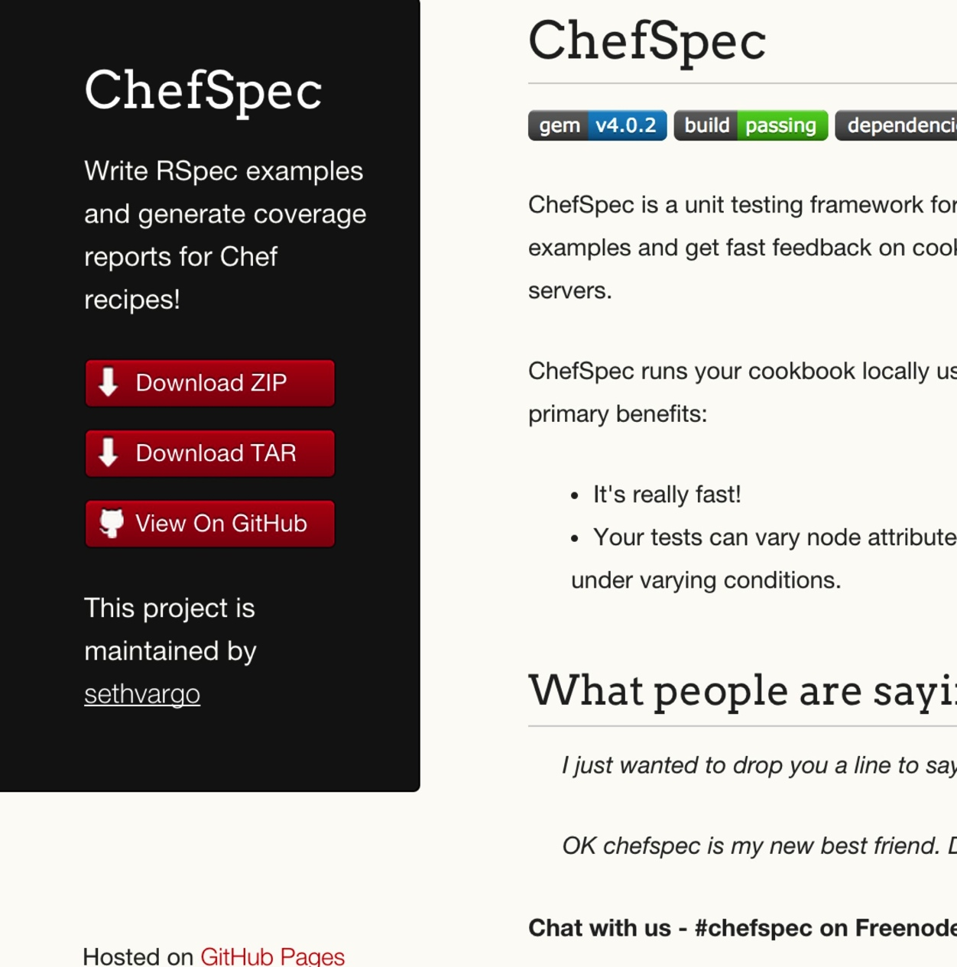
ChefSpec
Test before you converge
Get feedback on cookbook changes without the need for target servers
http://sethvargo.github.io/chefspec/

Slide 179
Make a directory for our ChefSpec tests
cd ~/chef-repo/cookbooks/apache
Notes:
~/chef-repo/cookbooks/apache/

Slide 180
Write a ChefSpec test
spec/unit/recipes/default_spec.rb
require 'spec_helper'
describe 'apache::default' do
context 'When all attributes are default, on an unspecified platform' do
let(:chef_run) do
runner = ChefSpec::ServerRunner.new
runner.converge(described_recipe)
end
it 'converges successfully' do
chef_run # This should not raise an error
end
end
end

Slide 181
Write a ChefSpec test
spec/unit/recipes/default_spec.rb
describe 'apache::default' do
context 'When all attributes are default, on an unspecified platform' do
let(:chef_run) do
runner = ChefSpec::ServerRunner.new
runner.converge(described_recipe)
end
it 'converges successfully' do
chef_run # This should not raise an error
end
it 'installs apache' do
expect(chef_run).to install_package 'apache2'
end
end
end

Slide 182
Run the ChefSpec tests
rspec spec
..
Finished in 1.19 seconds (files took 13.09 seconds to load)
2 examples, 0 failures

Slide 183
Break the cookbook
recipes/default.rb
package "apache"
service "apache2" do
action :start
end

Slide 184
Run the ChefSpec tests
rspec spec
.F
Failures:
1) apache::default When all attributes are default, on an unspecified platform installs apache
Failure/Error: expect(chef_run).to install_package 'apache2'
expected "package[apache2]" with action :install to be in Chef run. Other package resources:
package[apache]
# ./spec/unit/recipes/default_spec.rb:23:in `block (3 levels) in <top (required)>'
Finished in 1.18 seconds (files took 12.7 seconds to load)
2 examples, 1 failure

Slide 185
Fix the cookbook
recipes/default.rb
package "apache2"
service "apache2" do
action :start
end

Slide 186
Time to hack!
https://www.flickr.com/photos/peterpearson/424047087
Notes:
Go!
Get started on your own, let’s check-in again in 20 minutes or so.

Slide 187
Chef Testing
Did chef-client complete successfully?
Did the recipe put the node in the desired state?
Are the resources properly defined?
Does the code following our style guide?

Slide 188
Clean code
Follow best practices, avoid mistakes

Slide 189

Foodcritic
Check cookbooks for common problems
Style, correctness, deprecations, etc.
Included with ChefDK
http://www.foodcritic.io/

Slide 190
Change our recipe
recipes/default.rb
package_name = "apache2"
package "#{package_name}"
service "apache2" do
action :start
end

Slide 191
Run Foodcritic
foodcritic .
FC002: Avoid string interpolation where not required: ./recipes/default.rb:7

Slide 192
Chef Testing
Did chef-client complete successfully?
Did the recipe put the node in the desired state?
Are the resources properly defined?
Does the code following our style guide?

Slide 193
Next steps
Install ruby on the system
Install and configure passenger
Install and configure a database
Deploy the application
Demo the working solution
Notes:
We’ll work through as much of this as we can with the class leaving time for a full demo in the end
Participants will not be able to install the database in the docker instances but can do everything else

Slide 194
Wrapping Up

Slide 195
We’ve only scratched the surface
https://www.chef.io/chef/
Notes:
All Open Source!

Slide 196
Build Anything
Simple internal applications
Complex external applications
Workstations
Hadoop clusters
IaaS infrastructure
PaaS infrastructure
SaaS applications
Storage systems
You name it
http://www.flickr.com/photos/hyku/245010680/

Slide 197
And Manage it Simply
Automatically reconfigure everything
Linux, Windows, Unixes, BSDs
Load balancers
Metrics collection systems
Monitoring systems
Cloud migrations become trivial
http://www.flickr.com/photos/helico/404640681/

Slide 198
What questions do you have?
Ask us anything!
@nellshamrell
@nathenharvey
Thank you!

